Slide 1
PAPER TITLE
Full Name
Affiliation
OPTIONAL SUPPORTIVE TEXT OR LOGO GOES HERE

Slide 2
Section Divider Title on White Goes at Top with Font Size 32
OPTIONAL SUPPORTIVE TEXT GOES HERE with font size not smaller than 24

Slide 3
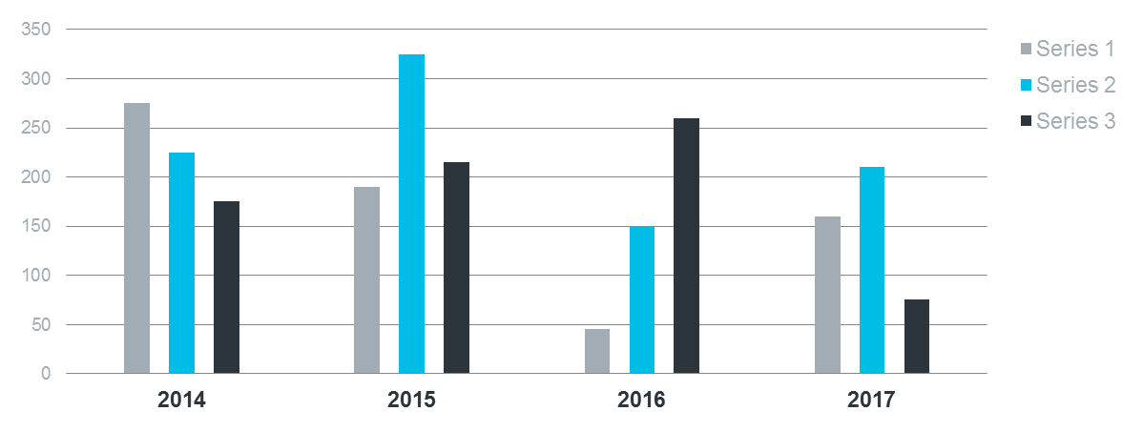
Section Divider Title on White Goes at Top with Font Size 32
Optional supportive text goes here with font size not smaller than 24

